Slide 1


Slide 2

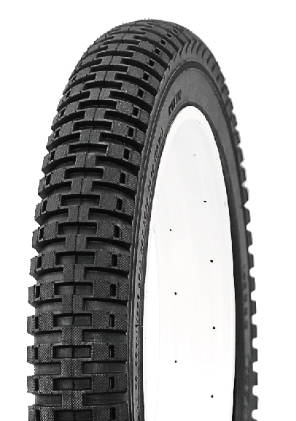
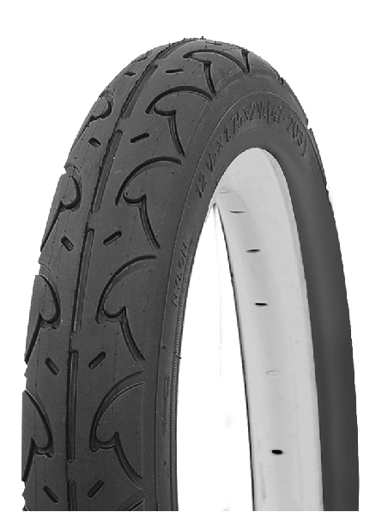
12 1/2x2 1/4
ITW001 | P1271
ITW002 | P1021
P1271
P1021
Wanda has been certified with the ISO 9001,ISO/TS16949 Quality Management System and ISO14001 Environmental Management System; Our products have passed CCC, ECE, INMETRO,DOT, SASO, GCC, ,BIS and Soncap Certificates.

Slide 3
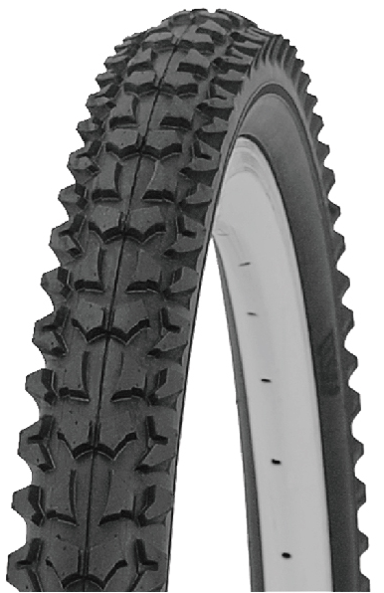
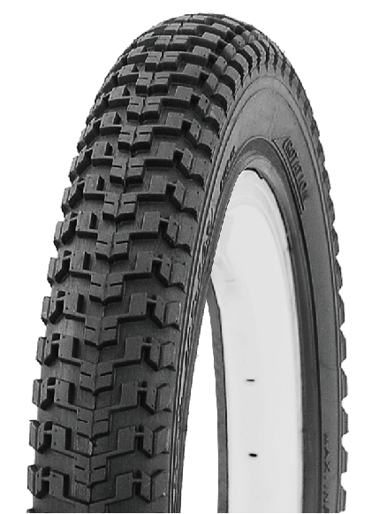
16X2.125
ITW003 | P1001
ITW004 | P1135
P1135
P1001
Wanda has been certified with the ISO 9001,ISO/TS16949 Quality Management System and ISO14001 Environmental Management System; Our products have passed CCC, ECE, INMETRO,DOT, SASO, GCC, ,BIS and Soncap Certificates.

Slide 4
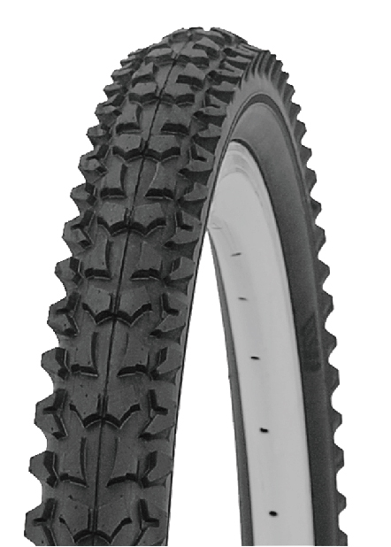
20x1.95
P1001
ITW005 | P1001
Wanda has been certified with the ISO 9001,ISO/TS16949 Quality Management System and ISO14001 Environmental Management System; Our products have passed CCC, ECE, INMETRO,DOT, SASO, GCC, ,BIS and Soncap Certificates.

Slide 5
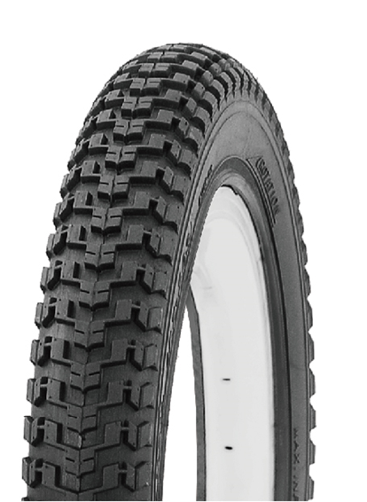
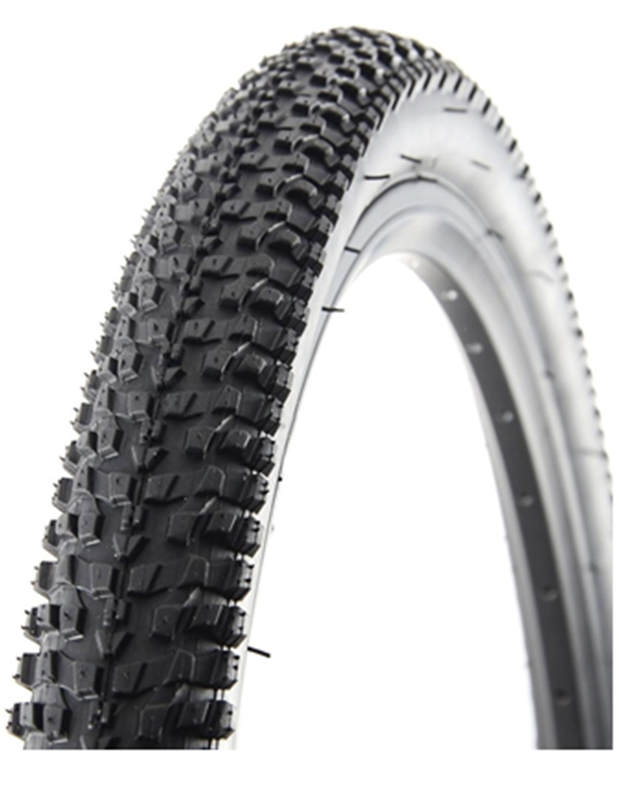
20x2.125
ITW006 | P1135
ITW008 | P1276
P1135
P1276
Wanda has been certified with the ISO 9001,ISO/TS16949 Quality Management System and ISO14001 Environmental Management System; Our products have passed CCC, ECE, INMETRO,DOT, SASO, GCC, ,BIS and Soncap Certificates.

Slide 6
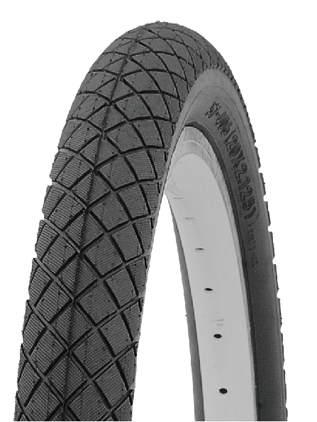
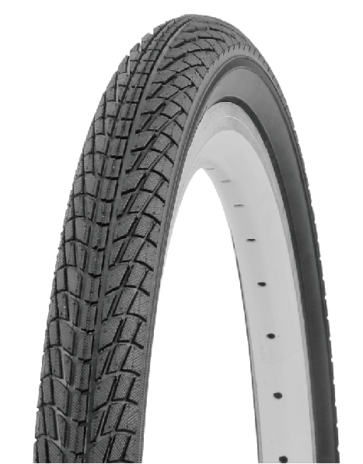
20x2.125
ITW007 | P1175
ITW009 | P1023
P1175
P1023
Wanda has been certified with the ISO 9001,ISO/TS16949 Quality Management System and ISO14001 Environmental Management System; Our products have passed CCC, ECE, INMETRO,DOT, SASO, GCC, ,BIS and Soncap Certificates.

Slide 7
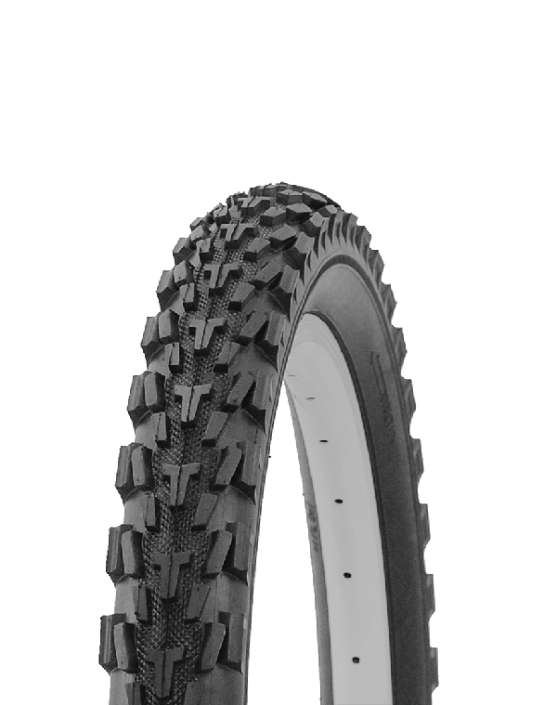
20x2.40
ITW010 | P1132
P1132
Wanda has been certified with the ISO 9001,ISO/TS16949 Quality Management System and ISO14001 Environmental Management System; Our products have passed CCC, ECE, INMETRO,DOT, SASO, GCC, ,BIS and Soncap Certificates.

Slide 8
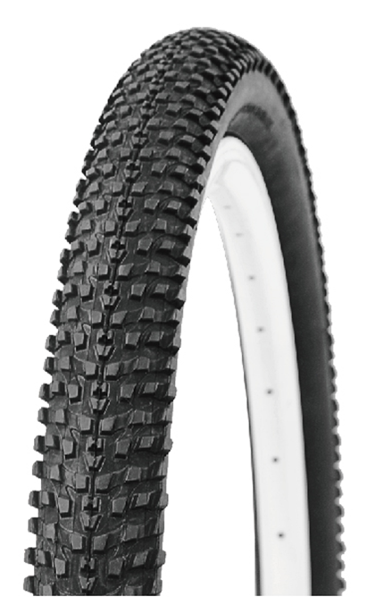
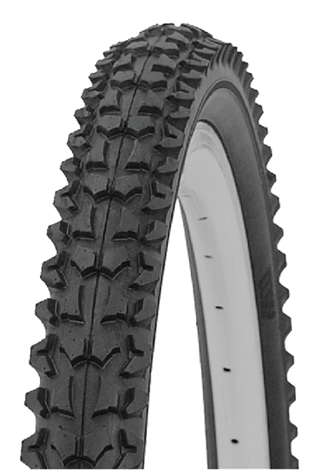
24x1.95
ITW011 | P1276
ITW012 | P1001
P1276
P1001
Wanda has been certified with the ISO 9001,ISO/TS16949 Quality Management System and ISO14001 Environmental Management System; Our products have passed CCC, ECE, INMETRO,DOT, SASO, GCC, ,BIS and Soncap Certificates.

Slide 9
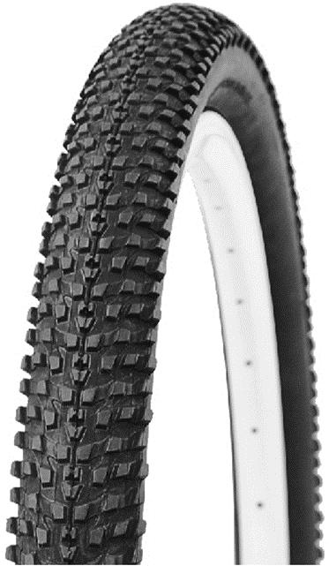
26x1.95
ITW013 | P1132
ITW014 | P1276
P1132
P1276
Wanda has been certified with the ISO 9001,ISO/TS16949 Quality Management System and ISO14001 Environmental Management System; Our products have passed CCC, ECE, INMETRO,DOT, SASO, GCC, ,BIS and Soncap Certificates.

Slide 10
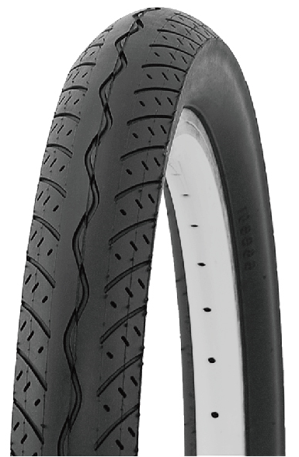
26x2.0
P1173
ITW015 | P1173
Wanda has been certified with the ISO 9001,ISO/TS16949 Quality Management System and ISO14001 Environmental Management System; Our products have passed CCC, ECE, INMETRO,DOT, SASO, GCC, ,BIS and Soncap Certificates.

Slide 11
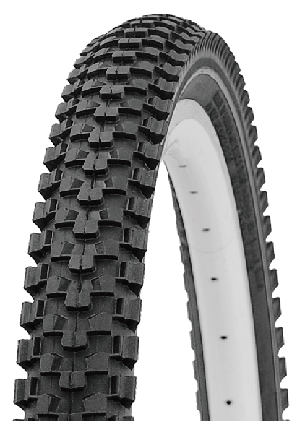
26x2.125
P1086
ITW017 | P1086
Wanda has been certified with the ISO 9001,ISO/TS16949 Quality Management System and ISO14001 Environmental Management System; Our products have passed CCC, ECE, INMETRO,DOT, SASO, GCC, ,BIS and Soncap Certificates.

Slide 12
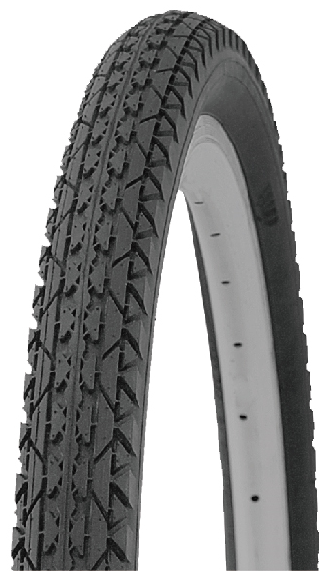
26x2x13/4
P123
ITW019 | P123
Wanda has been certified with the ISO 9001,ISO/TS16949 Quality Management System and ISO14001 Environmental Management System; Our products have passed CCC, ECE, INMETRO,DOT, SASO, GCC, ,BIS and Soncap Certificates.

Slide 13
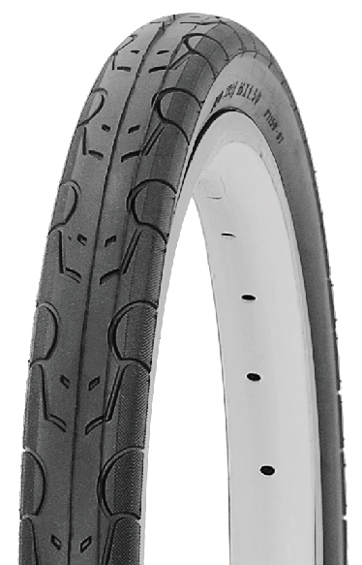
700x32C
P1159
ITW021 | P1159
Wanda has been certified with the ISO 9001,ISO/TS16949 Quality Management System and ISO14001 Environmental Management System; Our products have passed CCC, ECE, INMETRO,DOT, SASO, GCC, ,BIS and Soncap Certificates.

Slide 14
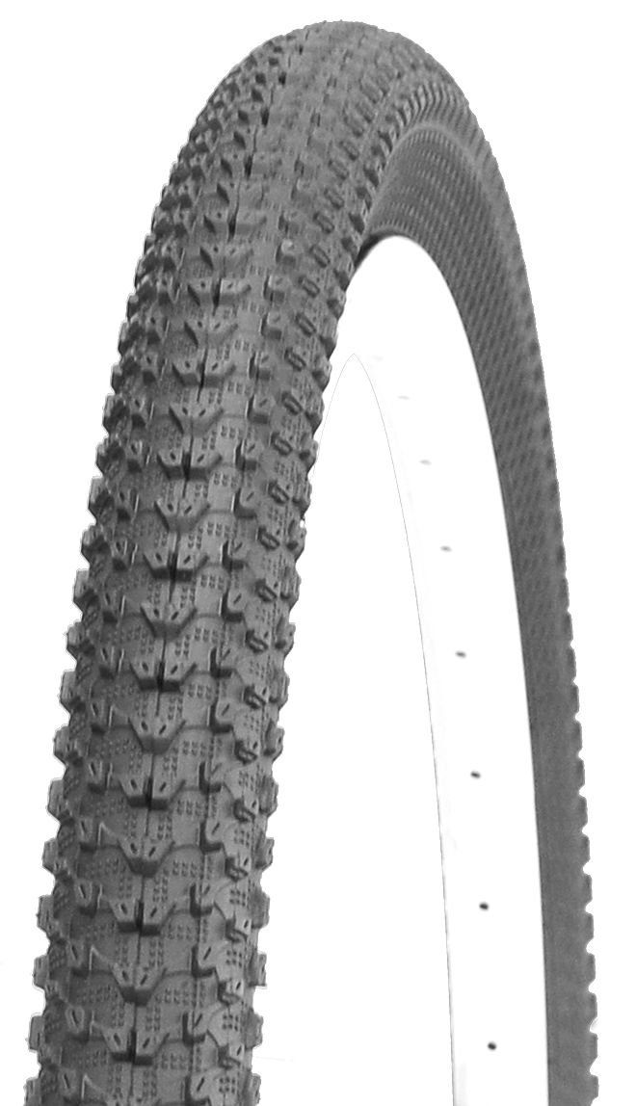
27.5x2.30
P1288
ITW023 | P1288
Wanda has been certified with the ISO 9001,ISO/TS16949 Quality Management System and ISO14001 Environmental Management System; Our products have passed CCC, ECE, INMETRO,DOT, SASO, GCC, ,BIS and Soncap Certificates.

Slide 15
29x2.35
P1288
ITW025 | P1288
Wanda has been certified with the ISO 9001,ISO/TS16949 Quality Management System and ISO14001 Environmental Management System; Our products have passed CCC, ECE, INMETRO,DOT, SASO, GCC, ,BIS and Soncap Certificates.

Slide 16

WANDA has been certified with the ISO 9001,ISO/TS16949 Quality Management System and ISO14001 Environmental Management System; Our products have passed CCC, ECE, INMETRO,DOT, SASO, GCC, ,BIS and Soncap Certificates.
Factory Appointed South African Distribution
116 Frederick street Marshalltown
Johannesburg, Gauteng, South Africa
Phone: +2711 3341106
E Mail : slotar@global.co.za
www.bslotar.co.za

